Slide 1

Capstone Project

Slide 2



Personal BACKGROUND
(Name, Past Experience, Qualification, Career Summary)
Name : Chandni Soni
Past Experience : no experience
Qualification : Graduate
www.collaberadigital.com

Slide 3


Knowledge before Training
Before starting my formal training, I gained foundational knowledge in several key areas of technology:
HTML & CSS: Developed a strong understanding of web structure and design principles, allowing me to create responsive and visually appealing web pages.
SQL: Familiar with database management, performing queries, and managing data through SQL.
Java: Basic programming skills in Java, including object-oriented concepts, problem-solving, and algorithm development.
Data Structure: Knowledage in DSA problem solving
This background provided me with the building blocks to advance further during my training.

Slide 4
Key Takeaways/Learnings from the Program (HTD)
Frontend Development:
HTML, CSS, JavaScript
Responsive Design
React: Learned how to build interactive user interfaces using React, including:
Material UI
Backend Development:
Node.js: Developed server-side applications using JavaScript.
MongoDB: Utilized MongoDB for efficient data storage.
Web Development Best Practices:
Sanitization and Validation:
Formik
Unit Testing: Implemented unit testing by jest
Soft Skills
Design Thinking: Adopted a user-centered approach to problem-solving and product design.
Software Development Life Cycle (SDLC): Gained an understanding of the various phases of SDLC
GenAI

Slide 5

Problem Statement of the Capstone Project
The goal of this capstone project is to develop a full-stack service booking platform where users can easily book services like cleaning, salon, spa, electrician, or plumbing. The platform enables two key user groups:
Customers:
. Users can browse and book various services based on their needs.
. They can schedule appointments and manage their bookings seamlessly.
Service Providers:
. Service providers can register themselves for the services they offer.
. Providers have access to a dashboard where they can track their bookings—viewing upcoming, ongoing, completed, and incomplete tasks—by logging into the system.

Slide 6
List of tools used for Capstone
React:
Frontend library for building dynamic user interfaces and handling client-side interactions.
Redux:
State management tool to efficiently manage and share data across components in the application.
Material UI:
Component library for building responsive and visually appealing user interfaces.
Node.js:
Backend runtime environment for building server-side applications with JavaScript.
MongoDB:
NoSQL database for storing and managing application data.
Jest:
Unit testing framework for ensuring code reliability and quality.
Visual Studio Code (VSCode):
Integrated development environment (IDE) used for writing and debugging code efficiently.

Slide 7
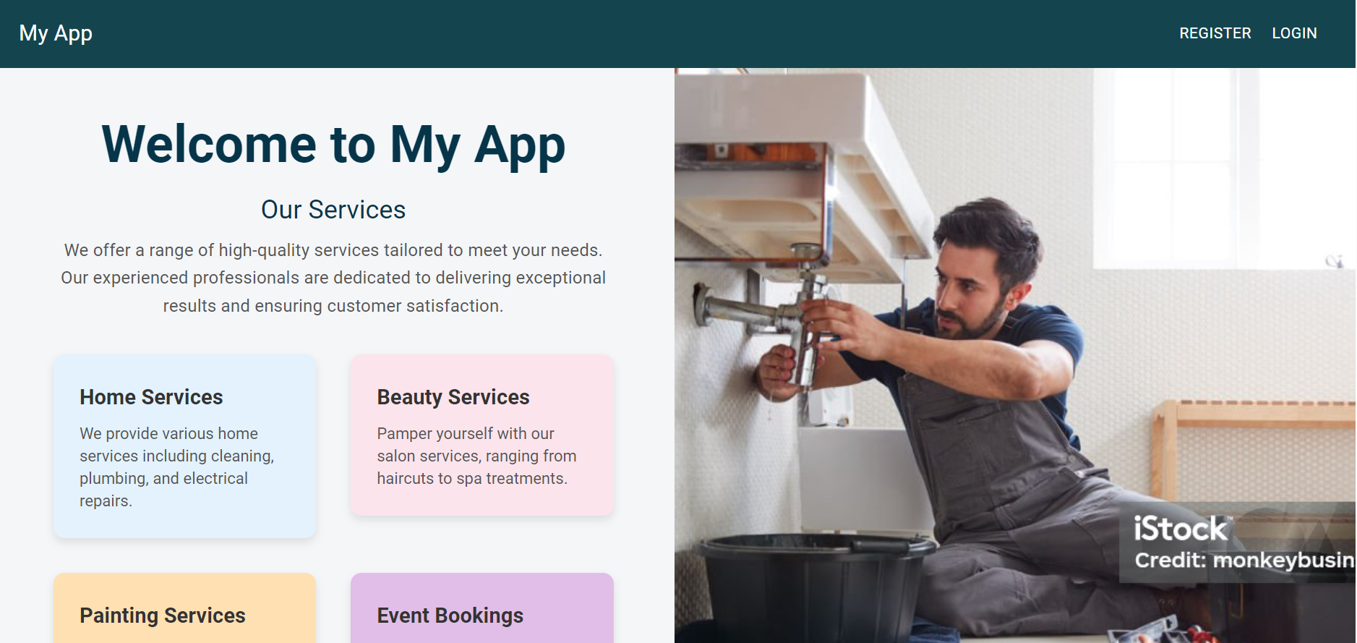
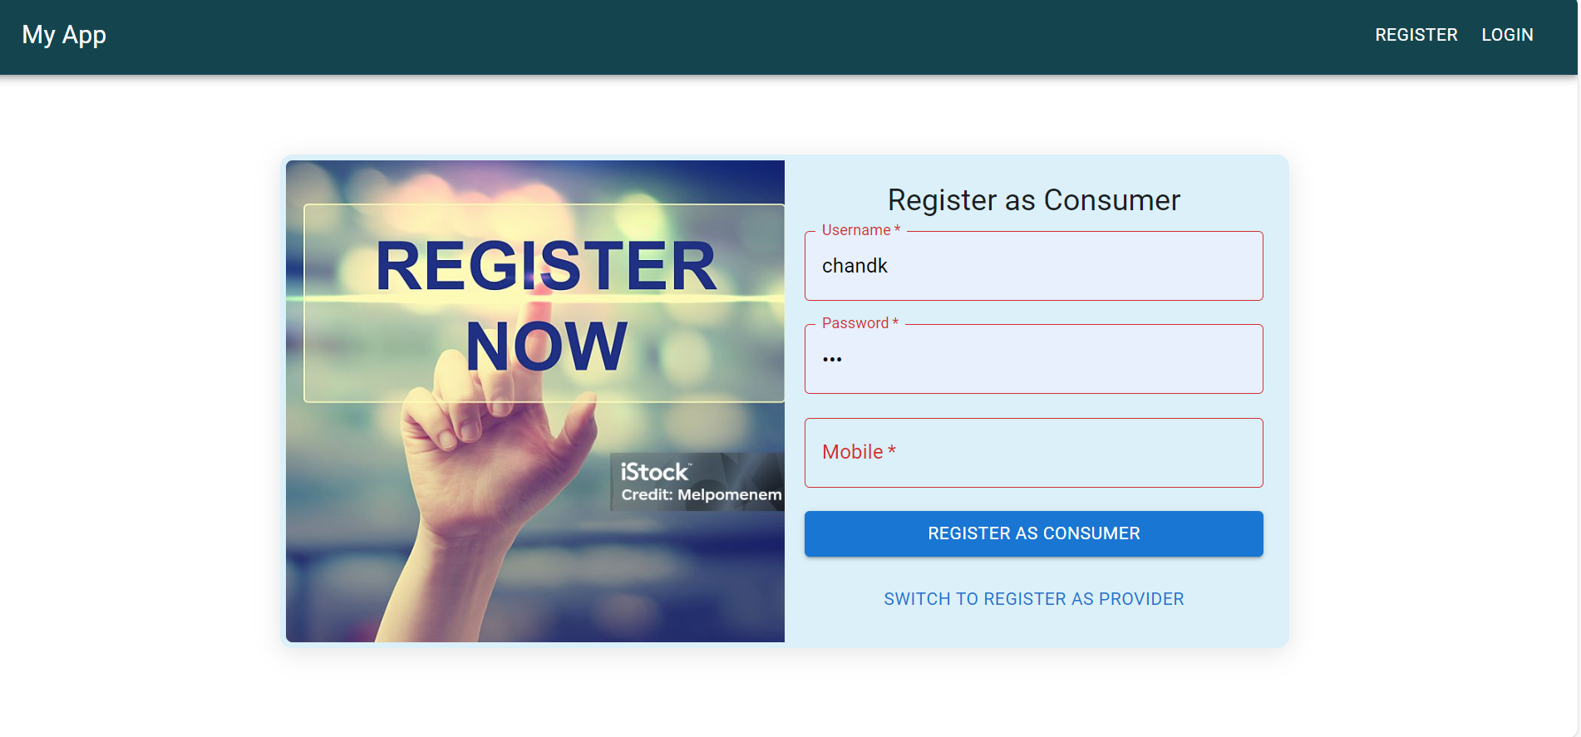
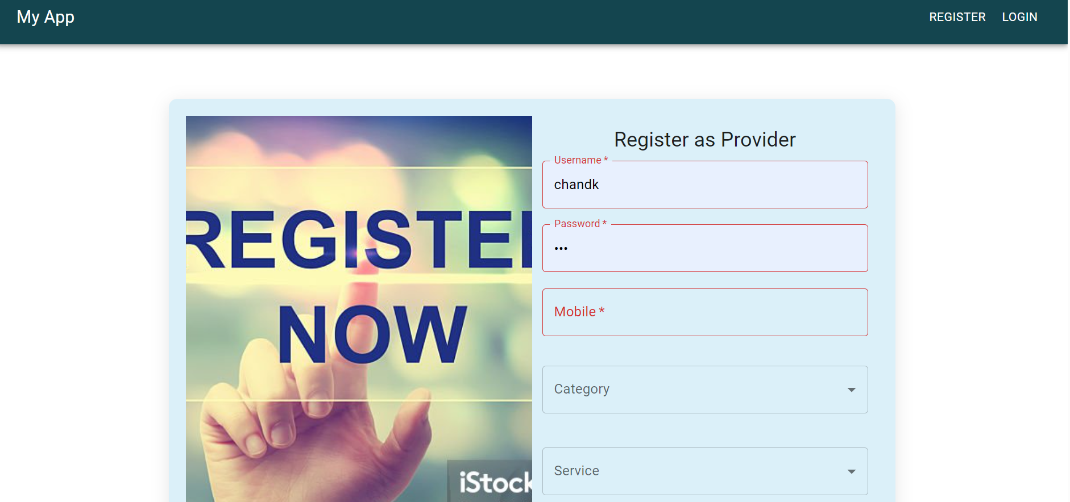
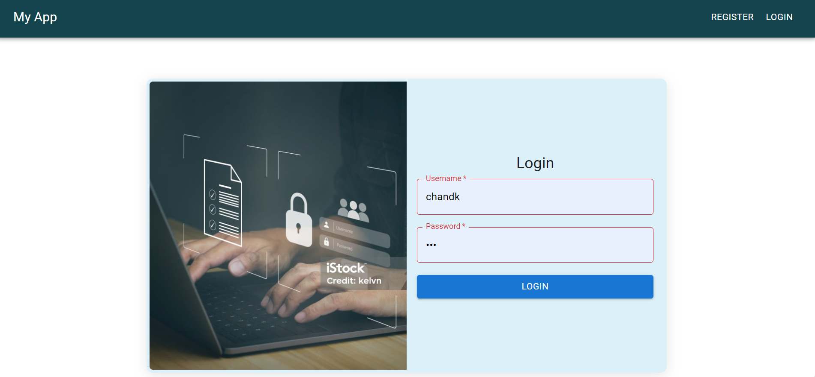
Important areas of the Project with screenshots
Home Page, Login Page , Register page for customer, register page for provider

Slide 8
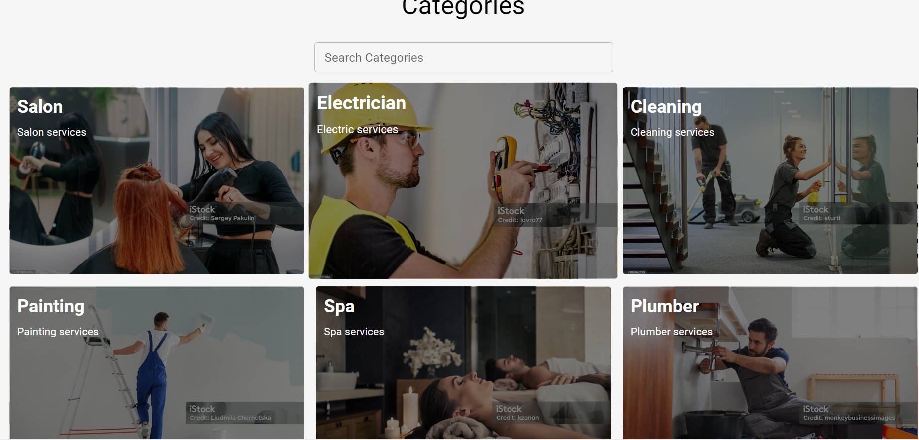
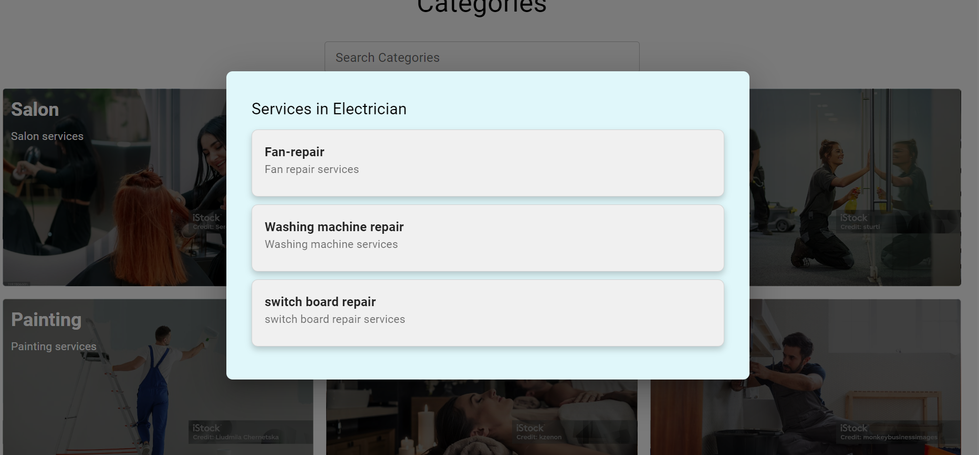
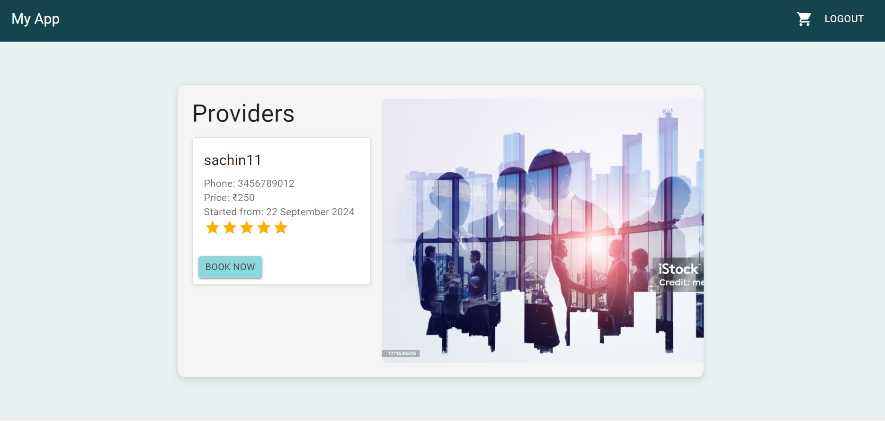
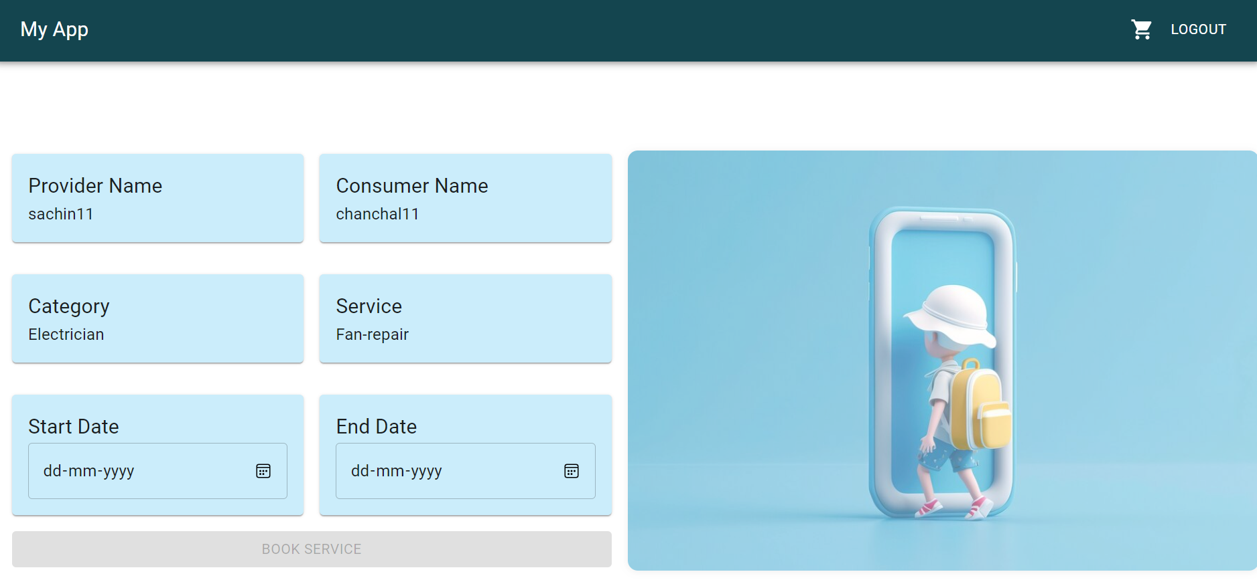
Important areas of the Project with screenshots
Categories Page, service list Page , provider list page , booking page

Slide 9
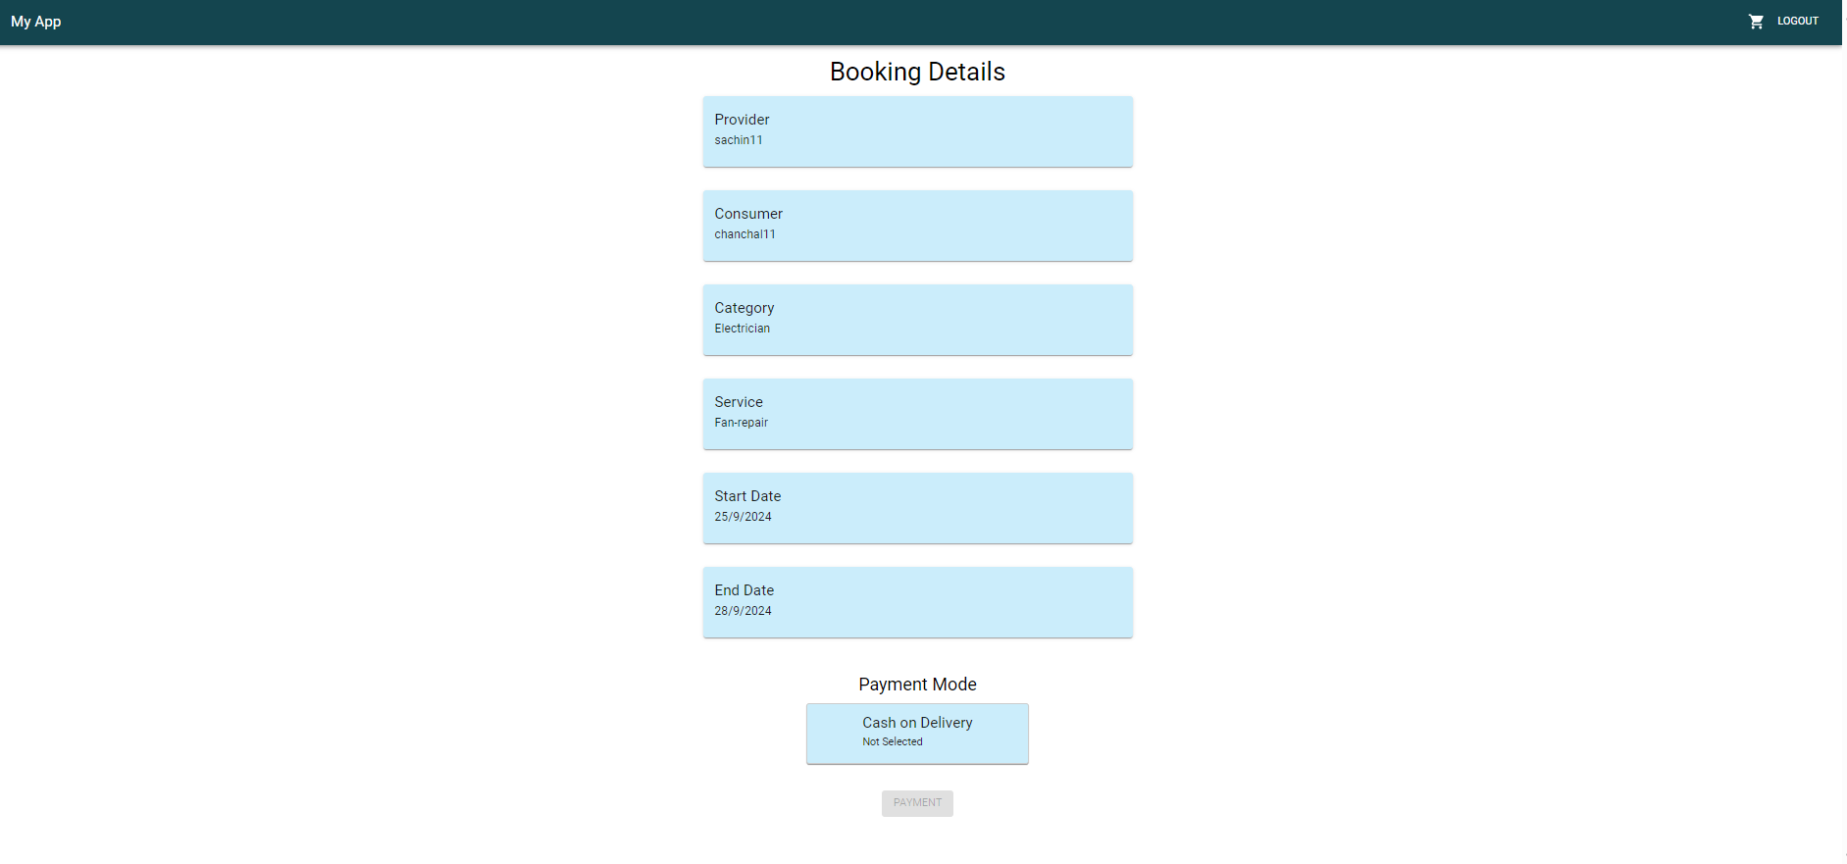
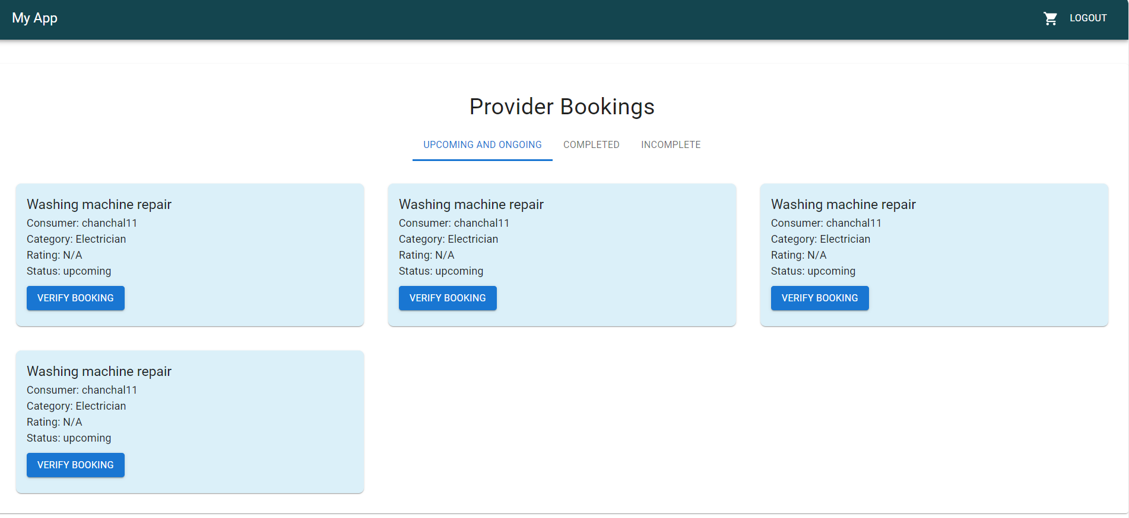
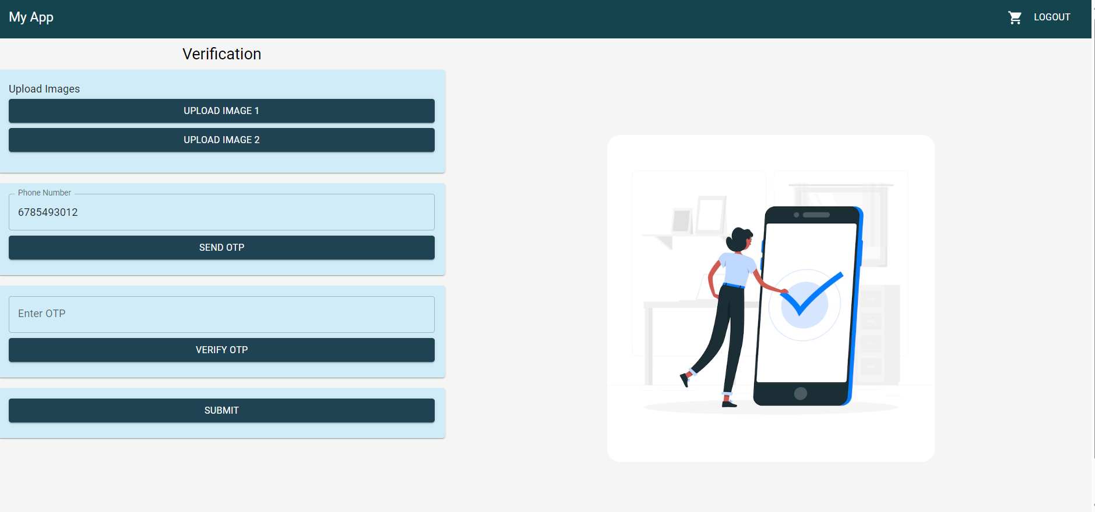
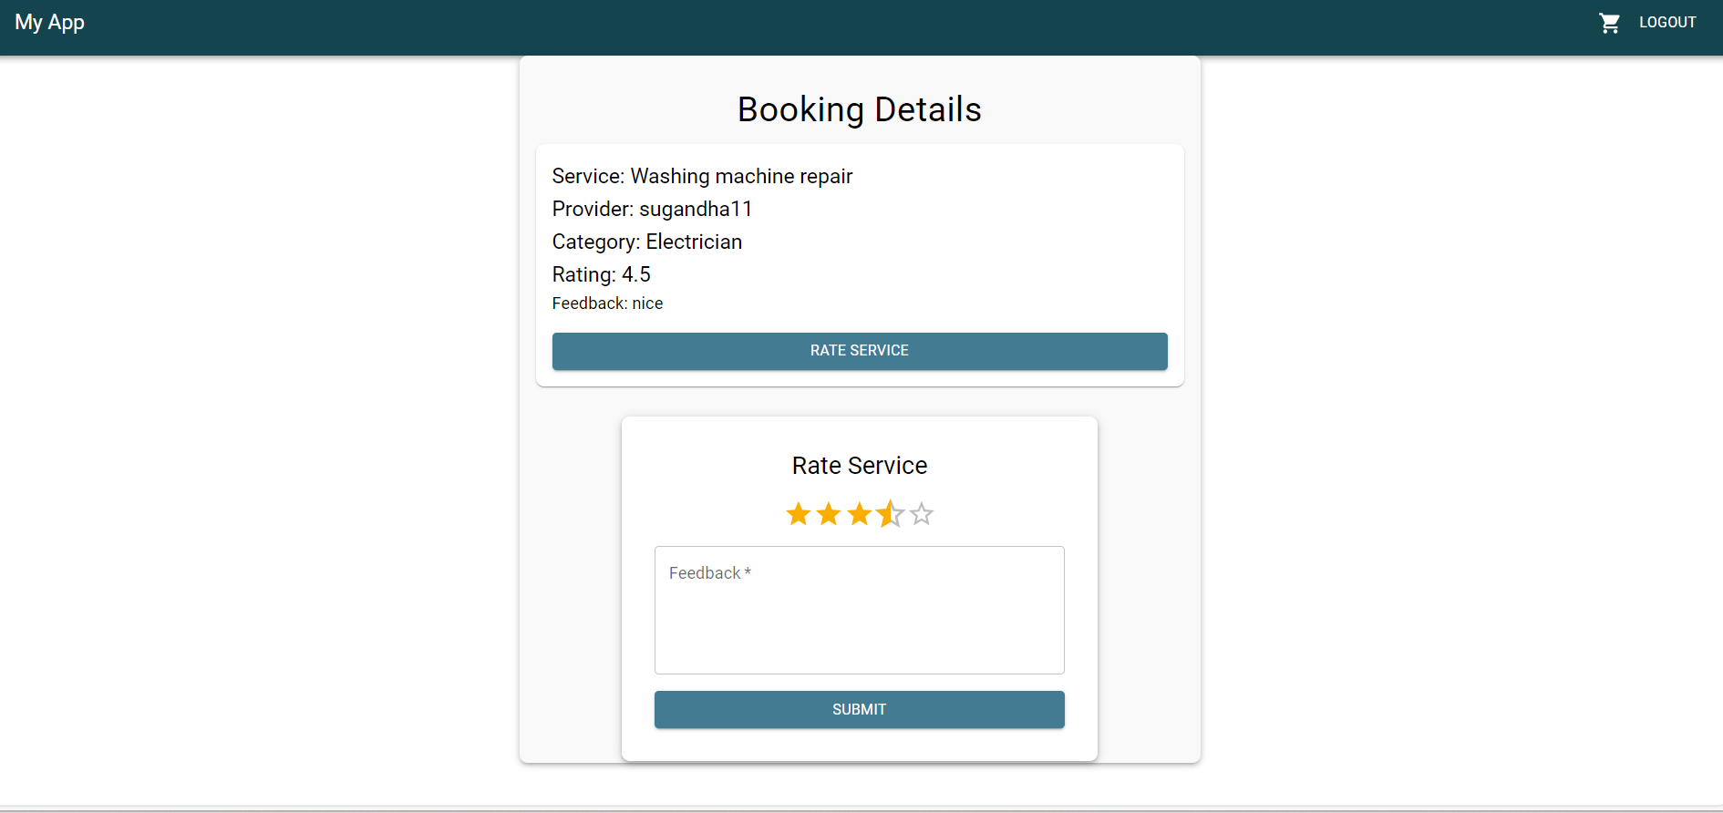
Important areas of the Project with screenshots
Payment Page, Provider booking list Page , verfication page , rating page​

Slide 10
Conclusion
Capstone project has provided a comprehensive understanding of full-stack web development, combining frontend and backend technologies to create a user-friendly service booking platform. By integrating tools like React, Redux, Node.js, and MongoDB, we successfully built a system where consumers can easily book services, and providers can manage their offerings efficiently. The project highlights key skills in building responsive UIs, managing state, securing data, and ensuring a seamless user experience. This platform not only simplifies service booking but also enhances productivity for service providers, demonstrating the practical application of modern web technologies.

Slide 11
Thank You

